Slide 1
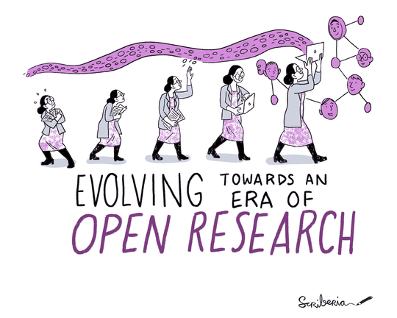


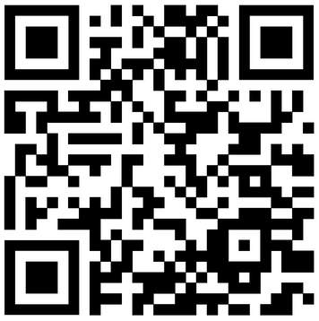
OPEN SCIENCE
TEAM AGREEMENT
WHAT IS OPEN SCIENCE?
Open Science is the principle and practice of making research products and processes available to all, while respecting diverse cultures, maintaining security and privacy, and fostering collaborations, reproducibility, and equity. -NASA TOPS
The Turing Way Community, & Scriberia. (2023). Illustrations from The Turing Way: Shared under CC-BY 4.0 for reuse. Zenodo. https://doi.org/10.5281/zenodo.7587336
WHAT IS THE OPEN SCIENCE TEAM AGREEMENT?
An Open Science Team Agreement gives researchers and other stakeholders the tools they need to understand and advocate for open science practices at a broader scale - within their laboratory, department, or the broader community.
WHAT DOES THE OPEN SCIENCE TEAM AGREEMENT COVER?
A team’s commitment to open science practices in the areas of:
Authorship and Collaboration
Articles and Research Materials
Data and Code
Communication and Impact
WHERE TO START
Here are the steps to take when creating an Open Science Team Agreement:
Assemble your team
Download a free copy of the Open Science Team Agreement Template
Tailor the agreement to reflect your team's values by working together
Share your revised agreement with others
Establish a schedule to review the agreement periodically.
To download and modify the template, scan the QR code or go to http://bit.ly/OSTeamAgreement
Open Science Team Agreements Infographic © 2023 by Samantha Wilairat, Sam Teplitzky, Ariel Deardorff is licensed under CC BY 4.0

